Slide 1
What Is A Neural Network? (Crash Course)
Presented by Ryan Melzer
A4H Summer 2022

Slide 2
What Is A Neural Network?
Neural networks (NNs) are a class of machine learning (ML) models that are loosely inspired by biological brains.
They consist of a mesh of artificial “neurons”, inspired by biological neurons, connected together, each of which receive an input (from other neurons), then do some computation on the input to produce an output (to other neurons).
Stack these artificial neurons vertically and horizontally on top of one another and boom… you’ve got yourself a bonafide NN. (I recognize this is a bit abstract, but bear with me!)
That seems simple… how do we get models that can write believable short stories (GPT-3), generate hyper-realistic human faces (StyleGAN), compete with pros at games like go and Starcraft (AlphaGo), generate high definition images from text descriptions (DALL-E 2), drive cars, diagnose diseases, reverse search images, face-app, text to speech and speech to text, replacing more and more software and an accelerating rate, the list goes on and on
First we need a short detour before diving in so we can all get on the same page…

Slide 3
What is ML? (other than a hip tech trend you can flaunt to gather VC money for your next startup)
I said NNs are ML models. What is ML? Before we can really understand what ML is, we have to understand something.
A fundamental concept in computing is the notion of an algorithm
An algorithm is simply a rigorous sequence of steps to accomplish a task. It’s sorta like a recipe. You get your inputs (ingredients), follow the cooking steps, and get an output (your dish).
Algorithm TieYourShoe:
Cross the laces
Loop one lace under the other
Pull the end of both laces
Make a loop in one lace
Etc…
Algorithm CountTo10:
Set your count to 0
Add 1 to your count
Yell the current value of your count
If your count is 10, STOP, else go to step 2.

Slide 4
How about an algorithm to sort a list of numbers? Can a non-CS-ECE person give me an algorithm to sort a list of numbers? A fast one?

Slide 5
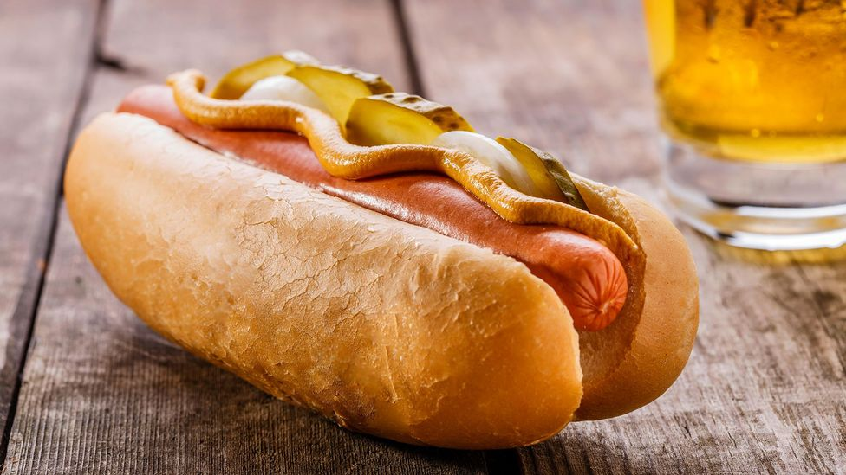
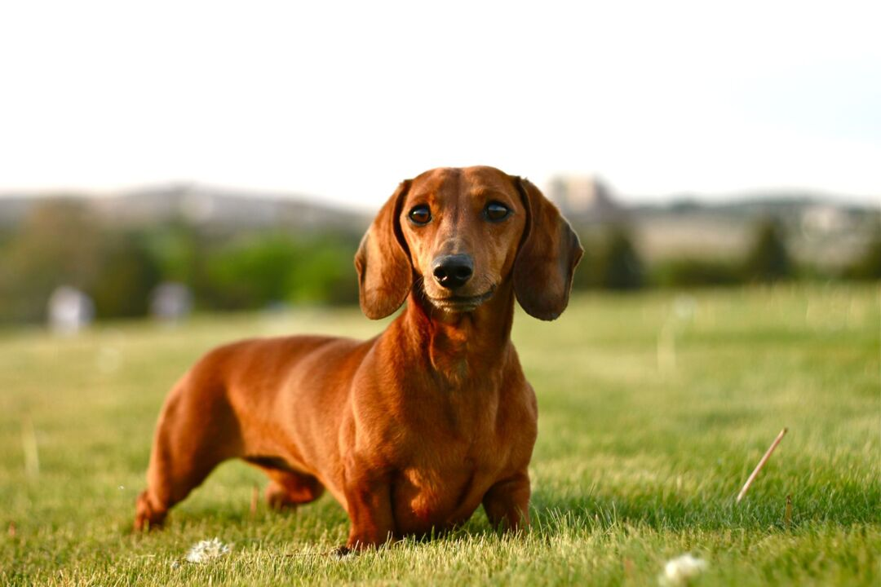
How about an algorithm to tell me if a picture is a picture of a hot dog or a dachshund?

Slide 6
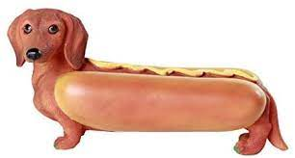
what would your algorithm do with this image?

Slide 7
Machine Learning
We’ve discussed algorithms which specify a rigorous sequence of steps to accomplish a task. More formally, we have an input, do some computation with that input, then produce an output.
BTW there is an entire field of study called “Theory of Computation” which formalizes the notion of an algorithm and uses rigorous math to characterize the fundamental capabilities and limitations of computers. Super cool!
Machine Learning is a sub-field of Artificial Intelligence that studies algorithms which learn their sequence of steps from data, rather than explicitly defining them.
Machine learning algorithms build a “model” from data, then use this model to predict outputs from inputs. Notice this “model” simply replaces the “computation” in our notion of an algorithm.
In most cases, we use an explicit (the steps are defined) “learning” algorithm which takes in data and produces the model.
So rather than having an algorithm for a problem, we have an algorithm that produces an algorithm for a problem given data about that problem.

Slide 8
Simple Machine Learning Use-Case Examples
Given a bunch of pictures we know are either hot dogs and dachshunds, learn a model to determine if a new picture is a hot dog or dachshund.
With the size and location of a house, predict it’s sale price given you know the size and location of other houses, along with their sale prices.
Group a large set of pictures of dogs together based on breed without knowing the breeds of any (a bit weirder under our definition of ML)
Beat a 6 year old at chess (even weirder)

Slide 9
Types of ML
Approaches to ML are typically divided into 3 broad categories in the textbooks, depending on the problem:
Supervised Learning: A learning algorithm is shown examples of input, output (labels) pairs and the goal is to learn a general “rule” that maps inputs to outputs
Unsupervised Learning: No labels are given to the learning algorithm. The algorithm finds structure in the data on it’s own, such as discovering hidden patterns, or reduce the dimensionality of data while preserving the structure and relationships of each example to one other example.
Reinforcement Learning: A learning algorithm interacts with a dynamic environment, such as a game, to maximize a reward (e.g. points in the game).
There are more, as well as combinations of the big 3, but these are the most fundamental and pretty much well-encapsulate the rest.

Slide 10
Simple Machine Learning Examples
Given a bunch of pictures we know are either hot dogs and dachshunds, learn a model to determine if a new picture is a hot dog or dachshund. (Supervised Learning, classification)
With the size and location of a house, predict it’s sale price given you know the size and location of other houses, along with their sale prices. (Supervised Learning, regression)
Group a large set of pictures of dogs together based on breed without knowing the breeds of any (Unsupervised Learning)
Beat a 6 year old at chess (Reinforcement Learning)

Slide 11
for the sake of time we are going to restrict ourselves here to supervised learning, which is really the most boring of the big 3, but the easiest and arguably most fundamental

Slide 12
Lets construct a simple neural net

Slide 13
Artificial Neurons in Detail
Artificial neurons are the fundamental building blocks of NNs, and represent the atomic units of computation inside of a network.
A neuron consists of:
An input vector x (inputs are also referred to as “features”)
A vector of weights W, with one weight per input value
A scalar bias b
An fixed non-linear activation function h
An activation a
The operation performed by a neuron produces activation a from input x. a is computed as:
a = h(x*W^{T} + b)
Input times weight, add a bias, activate!
W and b are the parameters of the neuron, and are learned by the learning algorithm.
x
a
h(x*W^{T} + b)

Slide 14

Artificial Neurons in Detail
one input value, one weight
x
a
h(w*x + b)
x1
x2
multiple inputs, one weight for each input, sum the result, add bias, activate
a
x3
h(($∑$wi*xi) + b)
x4
.
.
.
xN

Slide 15
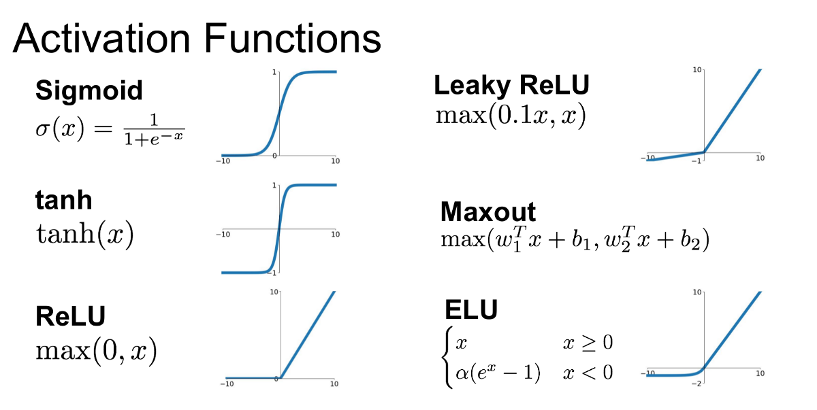
Artificial Neurons in Detail
Common activation functions (why we use these specific functions will make more sense later)

Slide 16
Building the network
The simplest NN “architecture” is the feed-forward network, also denoted as the multi-layer perceptron (MLP).
The term architecture refers to the type and configuration of the neurons and their connections. More on other architecture types later.
To construct a feed-forward neural network (FFNN), we create a directed acyclic graph of neuron layers (a stack of neurons) in a sequence such that each neuron in a layer receives an input from every neuron in the previous layer (a fully connected layer), with the exception of the input layer (no inputs) and the output layer (no layers after). Layer’s in-between the input and output are denoted hidden layers.
I know that’s a mouthful, a picture will clear it up.

Slide 17
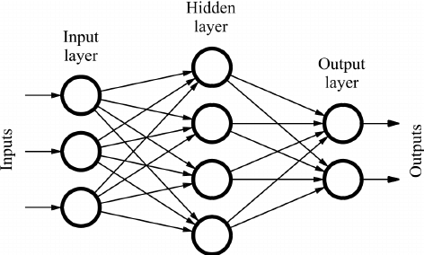
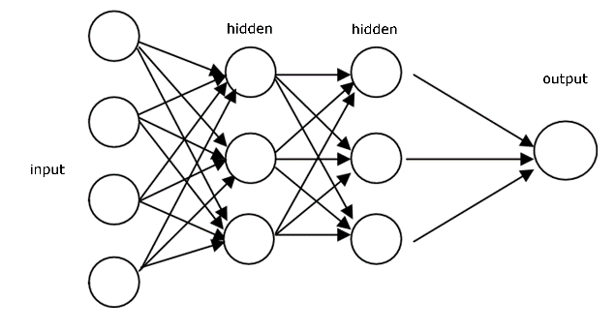

Building the network
x1
x2
x3
a
A single neuron
h(($∑$wi*xi) + b)
x4
.
.
.
xN
One hidden layer FFNN. Fully connected.
Two hidden layer FFNN. Fully connected.

Slide 18

What does the FFNN do?
x1
x2
x3
a
h(($∑$wi*xi) + b)
x4
.
.
.
Now that we have the model, what does it even do?! What’s going on?! Dave, where’s my medicine?!
The model learns a sequence of non-linear transformations to transform an input to a desired output.
The network is created with random parameters (weights) and the learning algorithm (discussed soon) learns the parameters (weights) of these transforms.
xN

Slide 19
Learning Features
x1
x2
x3
a
h(($∑$wi*xi) + b)
x4
.
.
.
Each intermediate layer learns new features derived from the previous layer’s features
xN
Input features
Hidden layer
size
family size
# bedrooms
Input vector x
walkability
House price
zip code
school quality
Output y
wealth

Slide 20
Learning Features
x1
x2
x3
a
h(($∑$wi*xi) + b)
x4
.
.
.
Input features
Hidden layer (fully connected)
xN
size
learned feature
family size
# bedrooms
learned feature
Input vector x
walkability
House price
zip code
learned feature
school quality
Output y
wealth

Slide 21

Learning Features
x1
x2
x3
a
h(($∑$wi*xi) + b)
x4
.
.
.
Input features
Hidden layer (fully connected)
xN
size
learned feature
family size
# bedrooms
learned feature
Input vector x
walkability
House price
zip code
Fully-connected layers can be expressed with a matrix multiplication
learned feature
school quality
Output y
wealth
$$a=h\left(x W^{T}+b\right)$$
$$x∈R^{4}, W∈R^{3x4}, b∈R^{4}, a∈R^{3}$$

Slide 22
Now let’s figure out how to learn these weights…

Slide 23
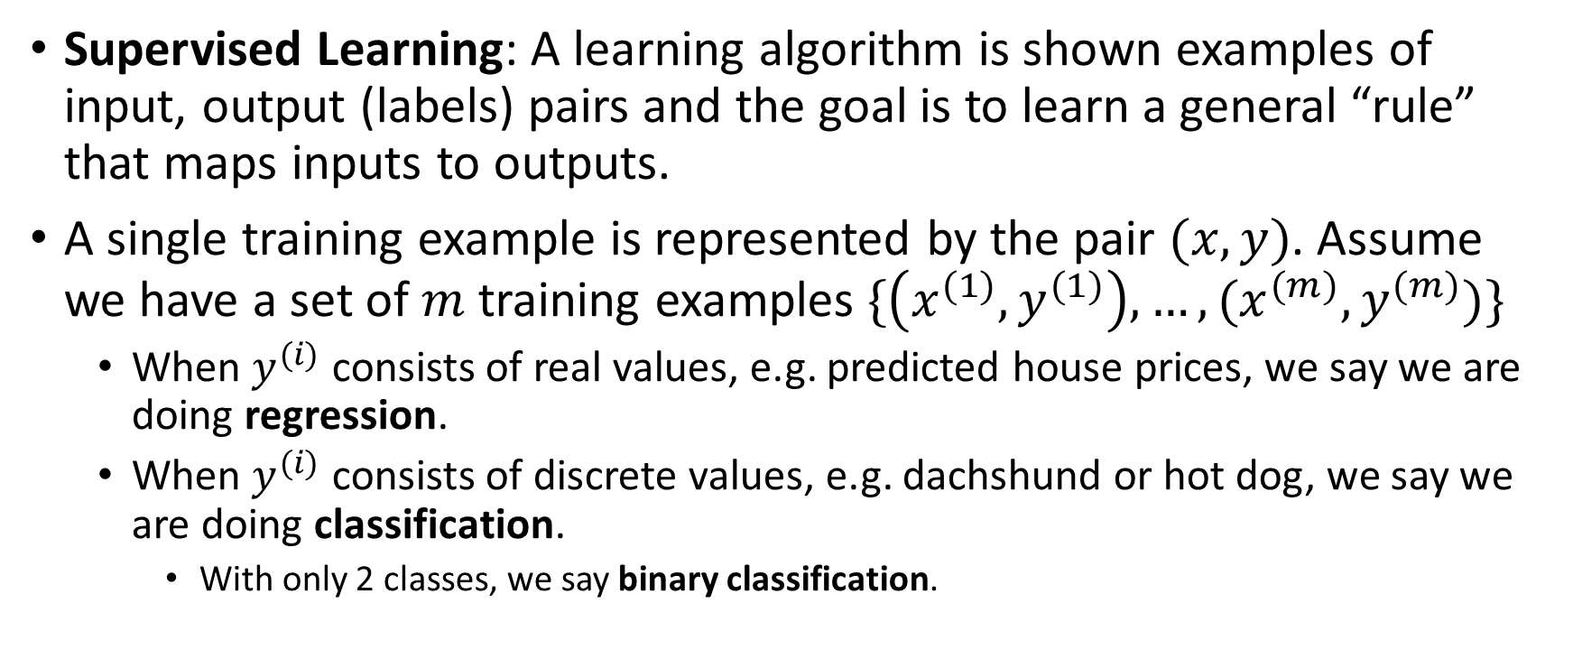
Supervised Learning
Supervised Learning: A learning algorithm is shown examples of input, output (labels) pairs and the goal is to learn a general “rule” that maps inputs to outputs.
A single training example is represented by the pair $(x, y)$. Assume we have a set of $m$ training examples $\{\left(x^{(1)}, y^{(1)}\right), …, (x^{(m)}, y^{(m)})\}$
When $y^{(i)}$ consists of real values, e.g. predicted house prices, we say we are doing regression.
When $y^{(i)}$ consists of discrete values, e.g. dachshund or hot dog, we say we are doing classification.
With only 2 classes, we say binary classification.

Slide 24
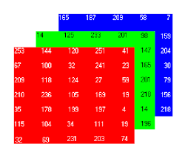



Binary Classification
Say we are trying to train our FFNN to learn dachshund or hot dog. Out input-output pairs are (image, hot dog or dachshund). We need to encode, our data in something that we can give to the neural net.
The encoding of our input will be the RGB pixel values of the images. Let’s assume that our images are 64x64 jpegs. Our input features are the 0-255 8-bit pixel values in each channel (R, G, and B):
$$64$$
$$3$$
$$64$$

Slide 25





Binary Classification
Our FFNN only accepts a $1xN$ vector, so we’ll need to flatten the image out for now:
x1
x2
.
.
.
x12288
R
G
$$64$$
B
$$3$$
$$64$$
$$64×64× 3=12288$$

Slide 26



Binary Classification
The encoding of our labels will just be $0$ for hot dog and $1$ for dachshund:
$$1$$
$$0$$

Slide 27


Binary Classification with a 1 neuron FFNN
Lets start with a 1 neuron FFNN to predict hot dog or dachshund. We are going to have our net predict $\hat{y}$, which we will interpret as $P\left(y=1 \right| x)$.
x1
x2
.
.
.
xN
x1
x2
h(($∑$wi*xi) + b)
$$\hat{y}$$
.
.
.
xN

Slide 28
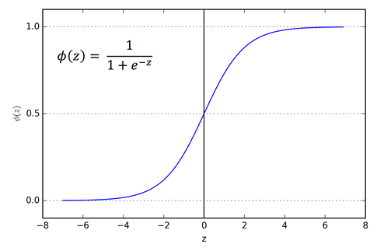
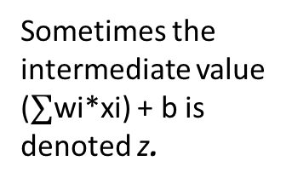
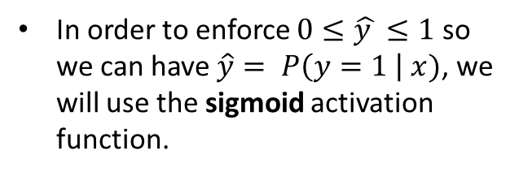

Binary Classification
x1
x2
.
.
.
xN
x1
x2
h(($∑$wi*xi) + b)
$$\hat{y}$$
.
.
.
xN
Sometimes the intermediate value ($∑$wi*xi) + b is denoted z.
In order to enforce $0≤\hat{y }≤1$ so we can have $\hat{y}= P\left(y=1 \right| x)$, we will use the sigmoid activation function.

Slide 29
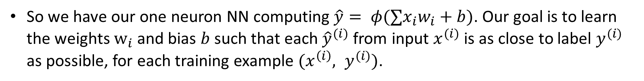
Binary Classification
x1
x2
.
.
.
xN
x1
x2
h(($∑$wi*xi) + b)
$$\hat{y}$$
.
.
.
xN
So we have our one neuron NN computing $\hat{y}= φ(∑x_{i}w_{i}+b)$. Our goal is to learn the weights $w_{i}$and bias $b$ such that each ${\hat{y}}^{(i)}$ from input $x^{(i)}$ is as close to label $y^{(i)}$ as possible, for each training example $(x^{\left(i\right)}, y^{(i)})$.

Slide 30
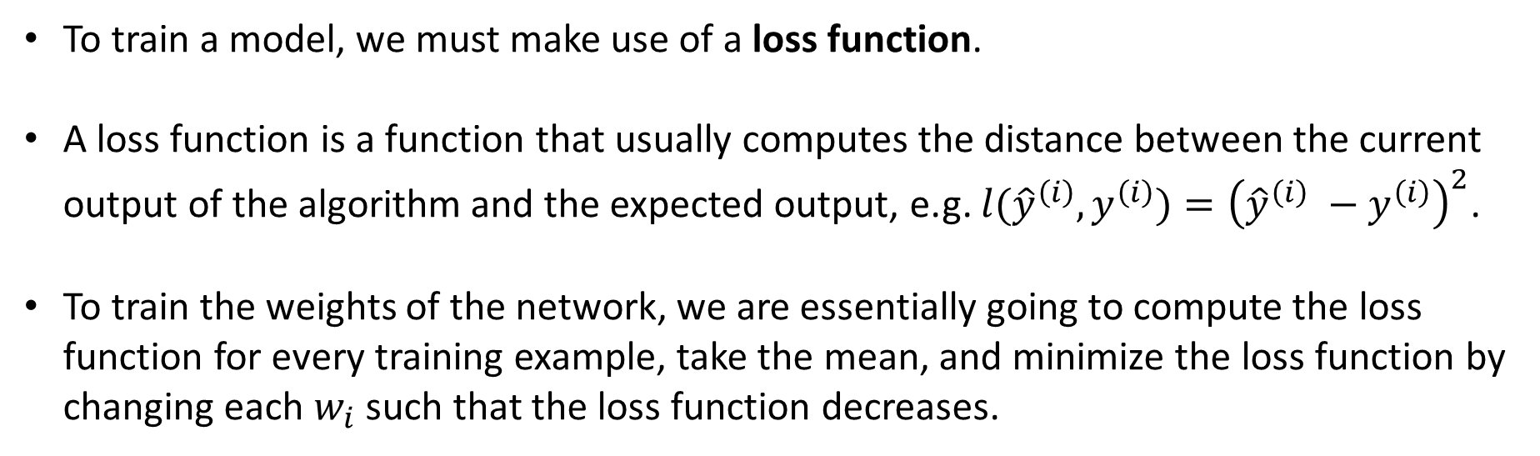
Loss functions
x1
x2
.
.
.
xN
x1
x2
h(($∑$wi*xi) + b)
$$\hat{y}$$
.
.
.
xN
To train a model, we must make use of a loss function.
A loss function is a function that usually computes the distance between the current output of the algorithm and the expected output, e.g. $l({\hat{y}}^{\left(i\right)},y^{\left(i\right)})={\left({\hat{y}}^{\left(i\right)} −y^{\left(i\right)}\right)}^{2}$.
To train the weights of the network, we are essentially going to compute the loss function for every training example, take the mean, and minimize the loss function by changing each $w_{i}$ such that the loss function decreases.

Slide 31
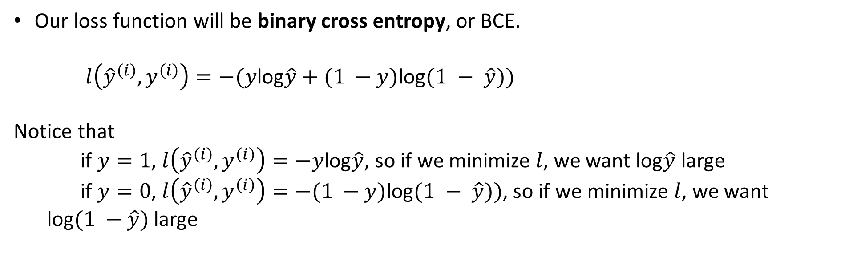
Loss Functions
x1
x2
.
.
.
xN
x1
x2
h(($∑$wi*xi) + b)
$$\hat{y}$$
.
.
.
xN
Our loss function will be binary cross entropy, or BCE.
$l\left({\hat{y}}^{\left(i\right)},y^{\left(i\right)}\right)=−(y$log$\hat{y}+(1 −y)\text{log}(1 − \hat{y}))$
Notice that
if $y=1$, $l\left({\hat{y}}^{\left(i\right)},y^{\left(i\right)}\right)=−y$log$\hat{y}$, so if we minimize $l$, we want log$\hat{y}$ large
if $y=0$, $l\left({\hat{y}}^{\left(i\right)},y^{\left(i\right)}\right)=−(1 −y)\text{log}(1 − \hat{y}))$, so if we minimize $l$, we want log$(1 −\hat{y})$ large

Slide 32
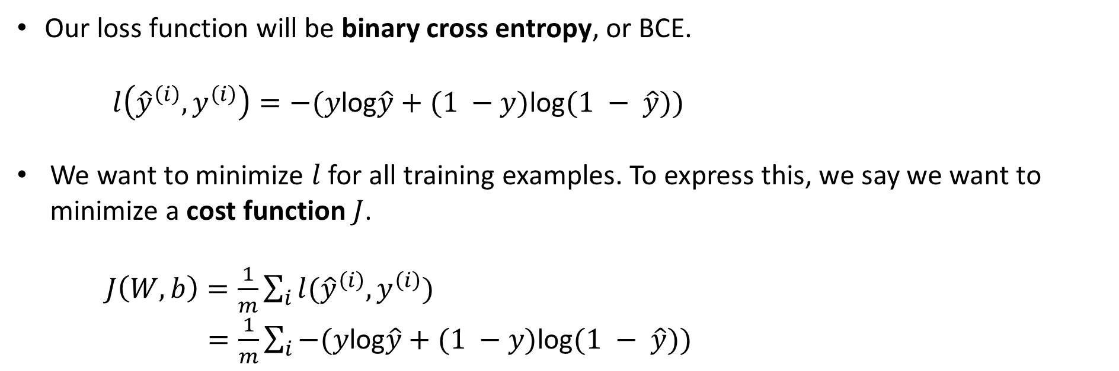
Cost functions
Our loss function will be binary cross entropy, or BCE.
$l\left({\hat{y}}^{\left(i\right)},y^{\left(i\right)}\right)=−(y$log$\hat{y}+(1 −y)\text{log}(1 − \hat{y}))$
We want to minimize $l$ for all training examples. To express this, we say we want to minimize a cost function $J$.
$J\left(W, b\right)=\frac{1}{m}\sum_{i}{l({\hat{y}}^{\left(i\right)},y^{\left(i\right)})}$
$=\frac{1}{m}\sum_{i}{−(y\text{log}\hat{y}+(1 −y)\text{log}(1 − \hat{y})) }$

Slide 33
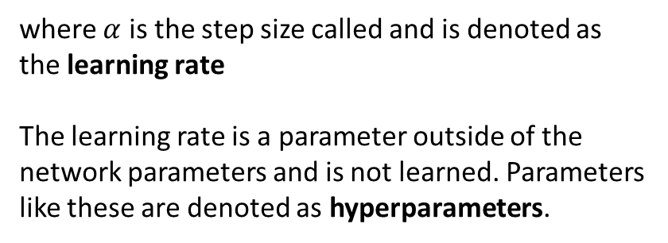
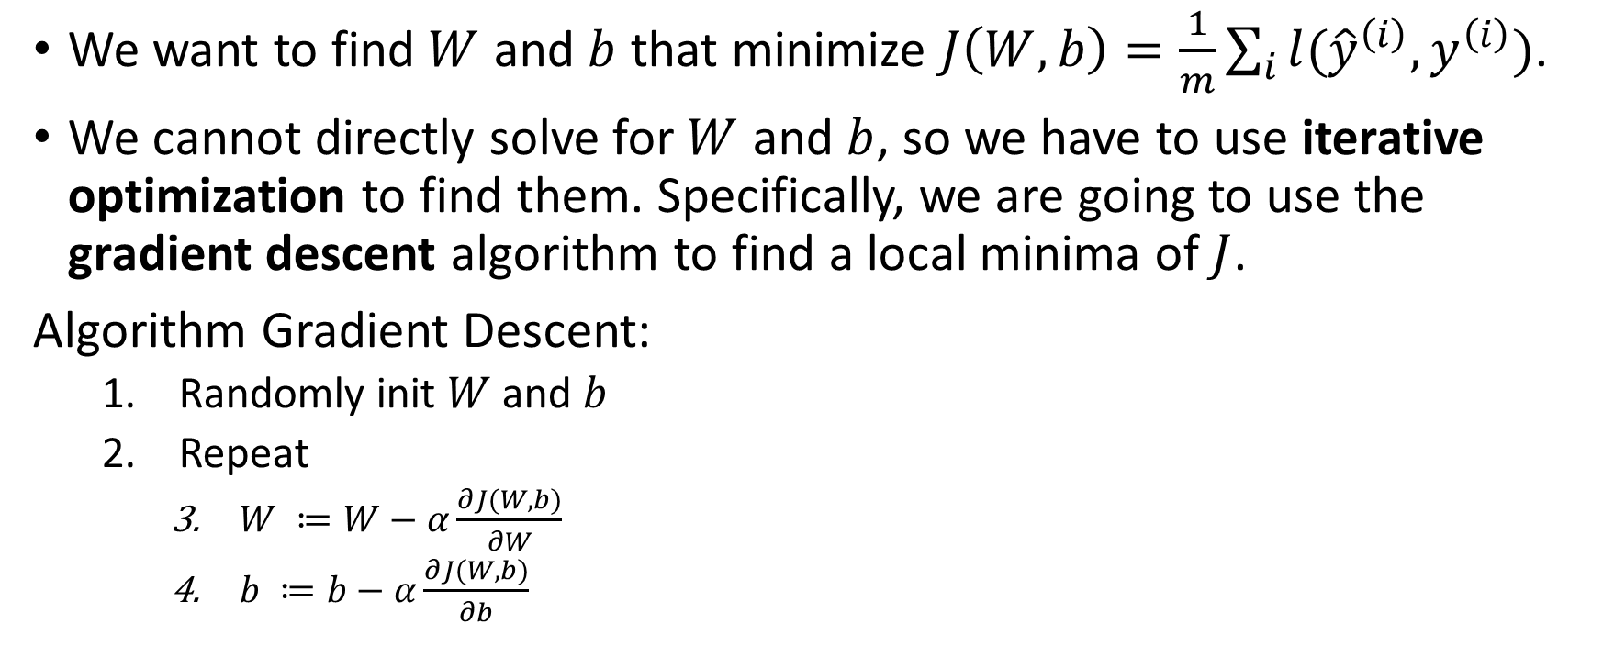
Minimizing Cost Functions
We want to find $W$ and $b$ that minimize $J\left(W, b\right)=\frac{1}{m}\sum_{i}{l({\hat{y}}^{\left(i\right)},y^{\left(i\right)})}$.
We cannot directly solve for $W$ and $b$, so we have to use iterative optimization to find them. Specifically, we are going to use the gradient descent algorithm to find a local minima of $J$.
Algorithm Gradient Descent:
Randomly init $W$ and $b$
Repeat
$W ≔W−α\frac{∂J(W,b)}{∂W}$
$b ≔b−α\frac{∂J(W,b)}{∂b}$
where $α$ is the step size called and is denoted as the learning rate
The learning rate is a parameter outside of the network parameters and is not learned. Parameters like these are denoted as hyperparameters.

Slide 34
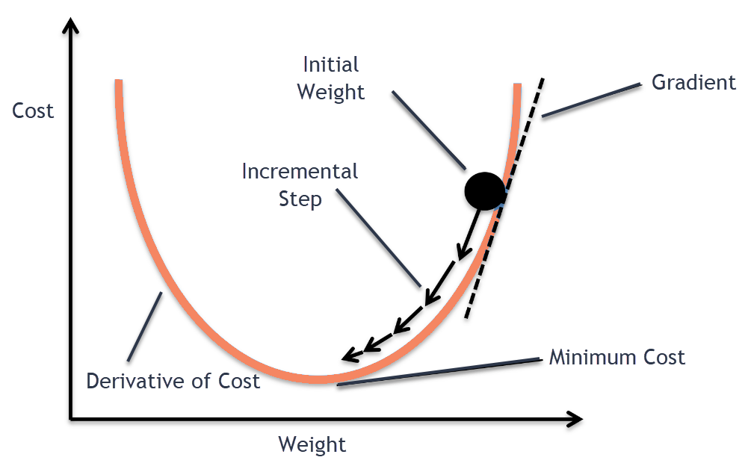
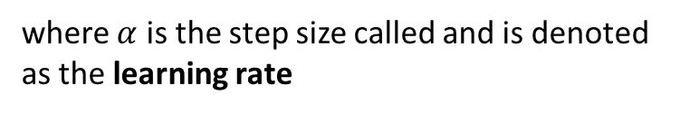
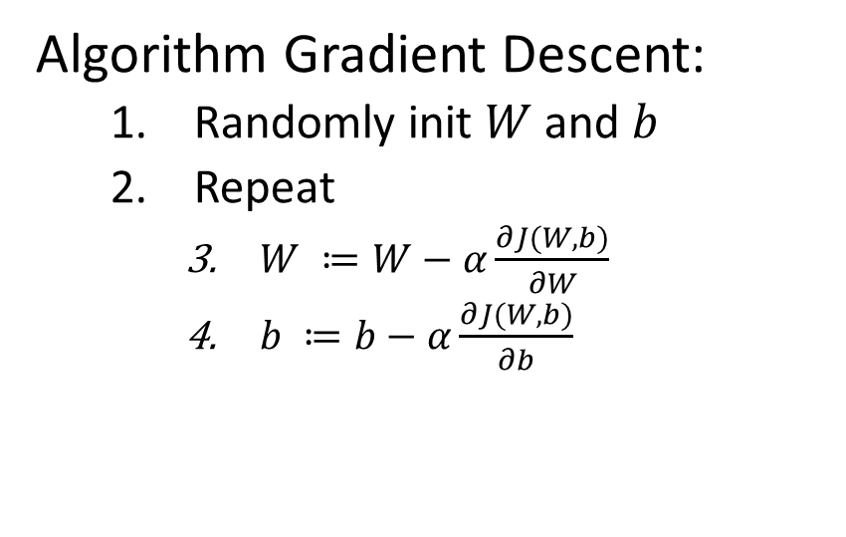
Gradient Descent
Algorithm Gradient Descent:
Randomly init $W$ and $b$
Repeat
$W ≔W−α\frac{∂J(W,b)}{∂W}$
$b ≔b−α\frac{∂J(W,b)}{∂b}$
where $α$ is the step size called and is denoted as the learning rate

Slide 35
Gradient Descent
Note: Binary Cross Entropy loss is convex for a single neuron NN. Cross entropy loss is in general non-convex, so minima are not global, hence network initialization matters

Slide 36
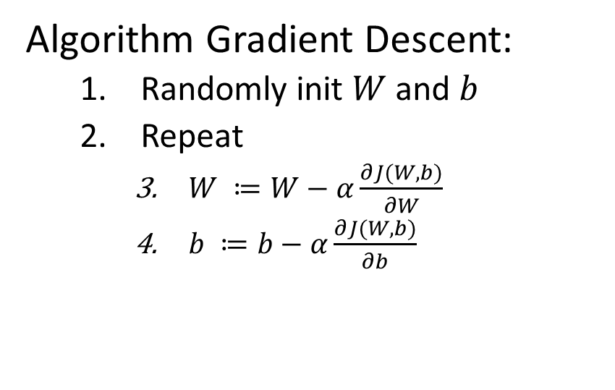
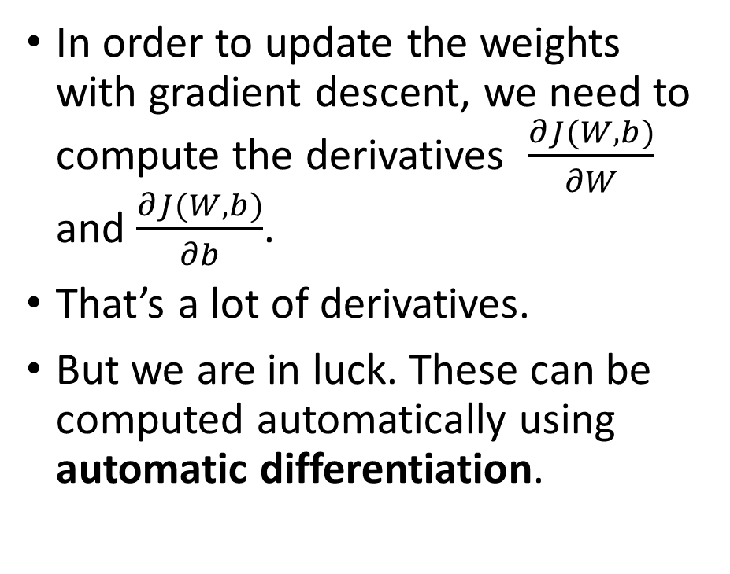
Gradient Descent: Computing Derivatives
In order to update the weights with gradient descent, we need to compute the derivatives $\frac{∂J(W,b)}{∂W}$ and $\frac{∂J(W,b)}{∂b}$.
That’s a lot of derivatives.
But we are in luck. These can be computed automatically using automatic differentiation.
Algorithm Gradient Descent:
Randomly init $W$ and $b$
Repeat
$W ≔W−α\frac{∂J(W,b)}{∂W}$
$b ≔b−α\frac{∂J(W,b)}{∂b}$

Slide 37
Automatic Differentiation
For the sake of time we wont talk in depth about AD. Essentially:
A neural network program and loss function are internally represented as a computation graph. The visual “neuron” representation is handy for learning, but not used in a NN program.
To get the loss function, we do a forward pass through the computation graph to get a loss value.
Automatic differentiation uses the chain rule to compute the derivatives of every term in the computation graph in a backwards pass through the network.
In deep learning, this automatic differentiation is known as backpropagation
Frameworks such as PyTorch and Tensorflow do this backwards pass for you
If you are interested in working in the field, I would strongly recommend learning these concepts in more detail.

Slide 38
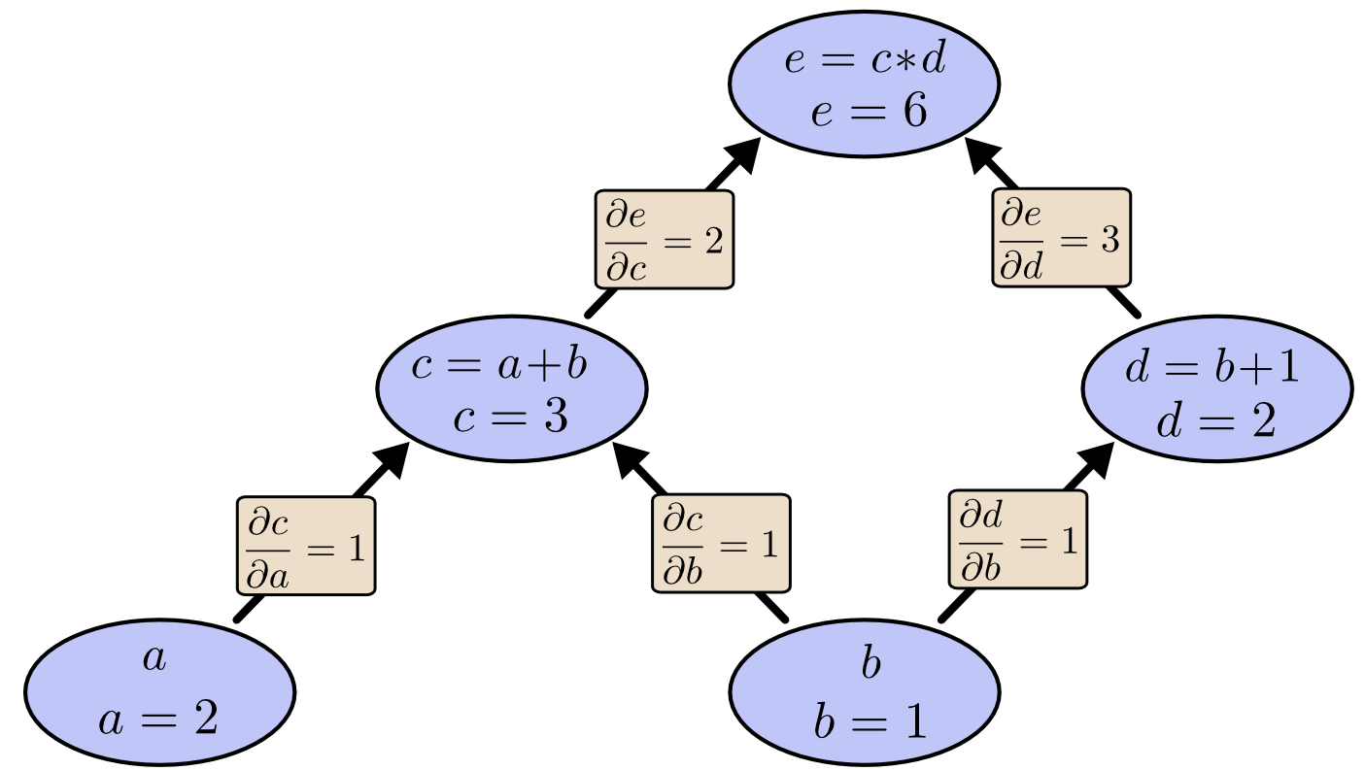
Computation Graph Example
Get derivatives using the chain rule in a backward pass

Slide 39
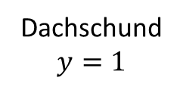

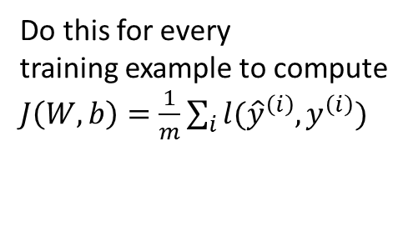
End-to-End Training (One Iteration)
x1
x2
.
.
.
xN
x1
x2
h(($∑$wi*xi) + b)
$$\hat{y}$$
.
.
.
xN
$l\left({\hat{y}}^{\left(i\right)},y^{\left(i\right)}\right)=−(y$log$\hat{y}+(1 −y)\text{log}(1 − \hat{y}))$
Dachschund
$$y=1$$
Forward pass to compute loss
Do this for every
training example to compute
$J\left(W, b\right)=\frac{1}{m}\sum_{i}{l({\hat{y}}^{\left(i\right)},y^{\left(i\right)})}$

Slide 40
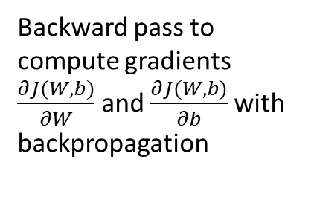
End-to-End Training (One Iteration)
x1
x2
h(($∑$wi*xi) + b)
$$\hat{y}$$
.
.
.
xN
$l\left({\hat{y}}^{\left(i\right)},y^{\left(i\right)}\right)=−(y$log$\hat{y}+(1 −y)\text{log}(1 − \hat{y}))$
Backward pass to compute gradients $\frac{∂J(W,b)}{∂W}$ and $\frac{∂J(W,b)}{∂b}$with backpropagation

Slide 41

End-to-End Training (One Iteration)
Use the computed gradients to make a step with gradient descent:
$$W ≔W−α\frac{∂J(W,b)}{∂W}$$
$$b ≔b−α\frac{∂J(W,b)}{∂b}$$
h(($∑$wi*xi) + b)

Slide 42
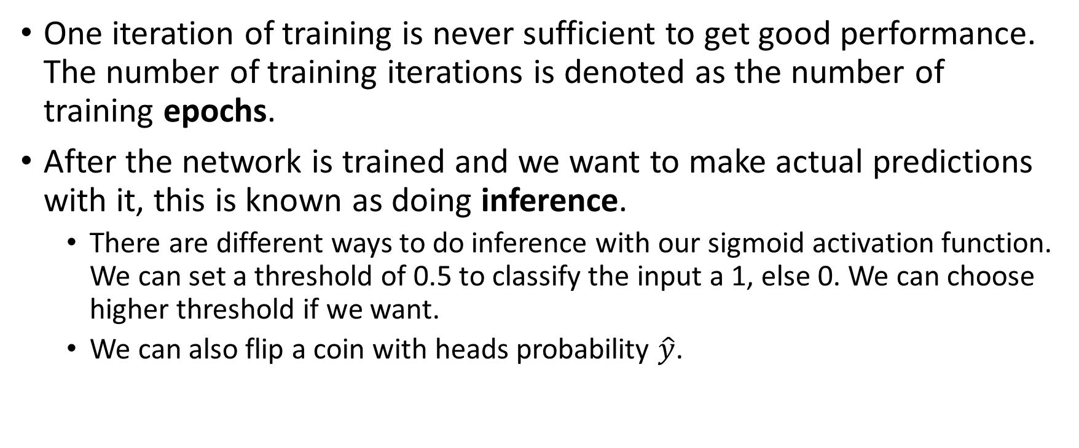
End-to-End Training
One iteration of training is never sufficient to get good performance. The number of training iterations is denoted as the number of training epochs.
After the network is trained and we want to make actual predictions with it, this is known as doing inference.
There are different ways to do inference with our sigmoid activation function. We can set a threshold of 0.5 to classify the input a 1, else 0. We can choose higher threshold if we want.
We can also flip a coin with heads probability $\hat{y}$.

Slide 43
End-to-End Training Intuition
The training procedure essentially adjusts individual weights depending on how “wrong” or “right” the model is on a given example and how much the weight influences the decision.
Every training iteration adjusts the weights like a bunch of little correlated knobs, turning them up or down all together to make the loss function a little bit smaller.
Do this enough and you’ll have a set of weights which can achieve a high accuracy on your training set.

Slide 44
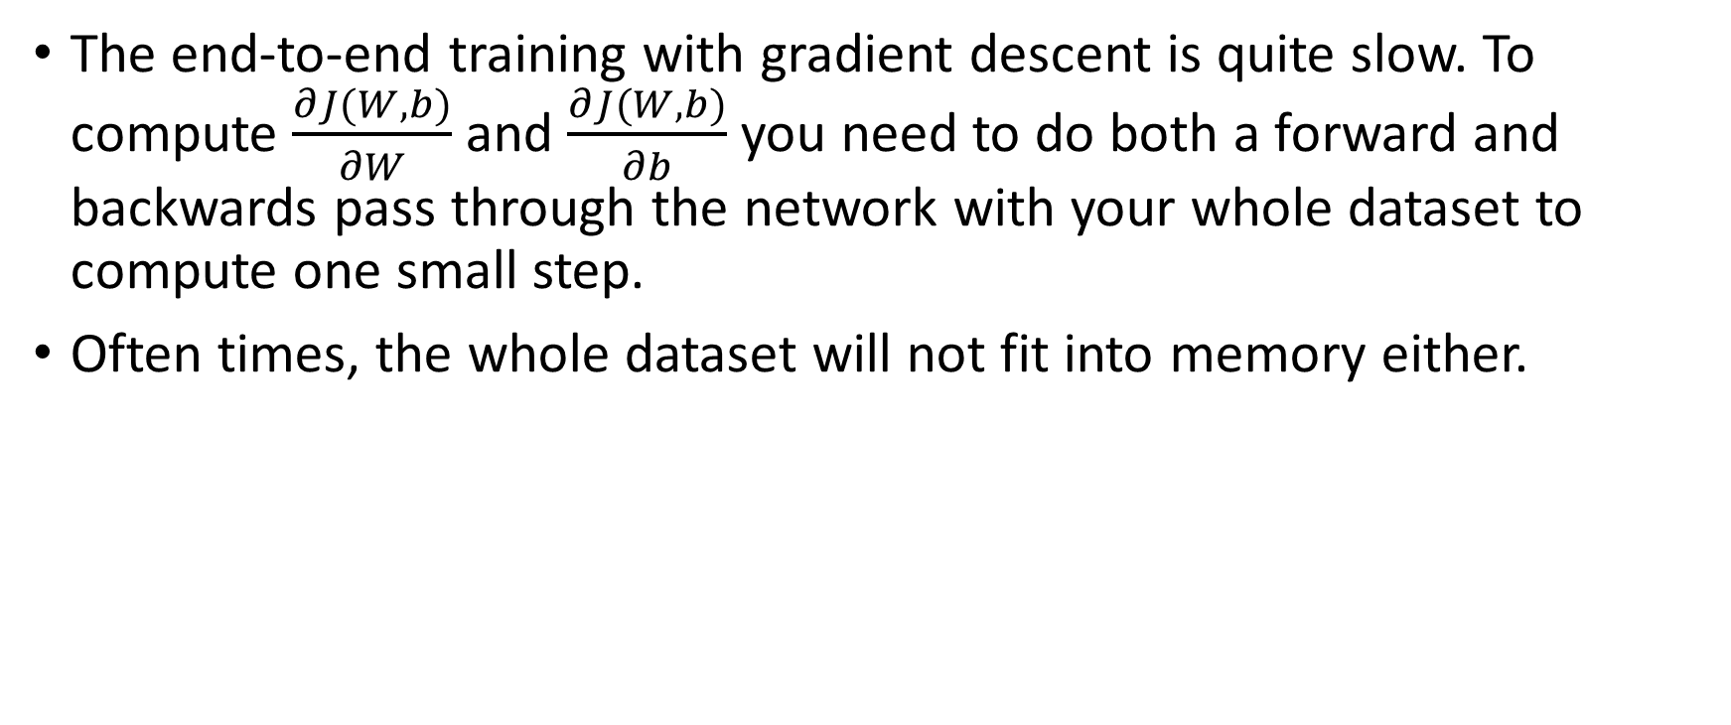
Gradient Descent issues
The end-to-end training with gradient descent is quite slow. To compute $\frac{∂J(W,b)}{∂W}$ and $\frac{∂J(W,b)}{∂b}$ you need to do both a forward and backwards pass through the network with your whole dataset to compute one small step.
Often times, the whole dataset will not fit into memory either.

Slide 45
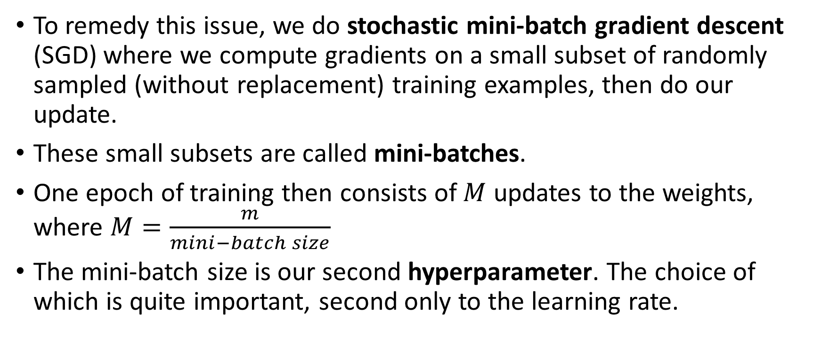
Stochastic Mini-batch Gradient Descent
To remedy this issue, we do stochastic mini-batch gradient descent (SGD) where we compute gradients on a small subset of randomly sampled (without replacement) training examples, then do our update.
These small subsets are called mini-batches.
One epoch of training then consists of $M$ updates to the weights, where $M=\frac{m}{mini−batch size}$
The mini-batch size is our second hyperparameter. The choice of which is quite important, second only to the learning rate.

Slide 46
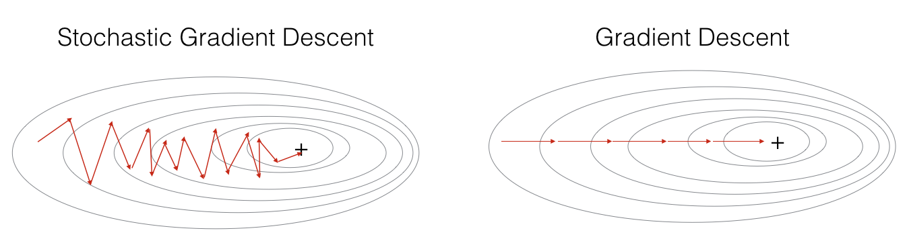
Stochastic Mini-batch Gradient Descent
Loss landscape
Advanced note: You might be wondering if approximating the gradients in this way affects performance. It does, but in fact it affects performance in a positive way. Neural network losses are highly non-convex, and the oscillations introduced by SGD enables the optimization procedure to find better local minima, which helps the model generalize better.

Slide 47
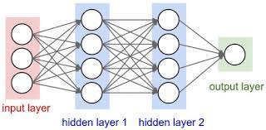

Making a larger FFNN
So far we have only been discussing a one neuron FFNN, however with everything we have discussed up until this point, it is simple to extend our one-neuron neural net to any number of neurons and layers, the training is the same. Forward pass to compute the loss, backward pass to compute all the gradients.
x1
x2
.
.
.
xN
$$\hat{y}$$

Slide 48
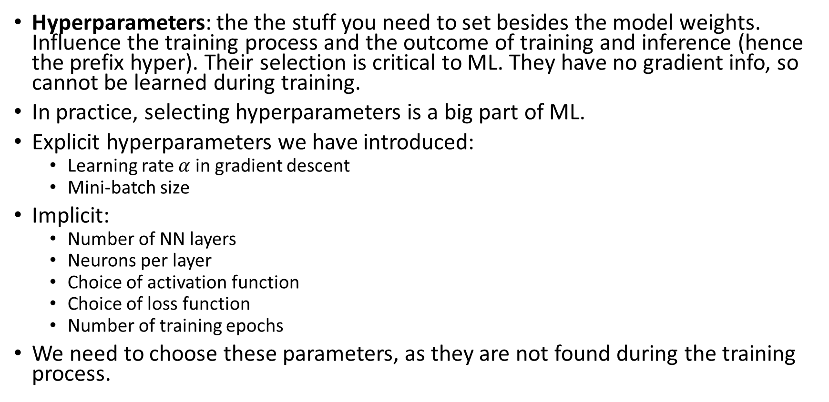
Hyperparameters
Hyperparameters: the the stuff you need to set besides the model weights. Influence the training process and the outcome of training and inference (hence the prefix hyper). Their selection is critical to ML. They have no gradient info, so cannot be learned during training.
In practice, selecting hyperparameters is a big part of ML.
Explicit hyperparameters we have introduced:
Learning rate $α$ in gradient descent
Mini-batch size
Implicit:
Number of NN layers
Neurons per layer
Choice of activation function
Choice of loss function
Number of training epochs
We need to choose these parameters, as they are not found during the training process.

Slide 49
Hyperparameters
Some of these parameters are more important than others.
Learning rate is selection can be quite sensitive and is probably the most important, closely followed by batch size in the majority of applications.
On the other hand, some are usually OK to just stick to the defaults because small changes in them don’t influence learning enough to really worry about
This is something you get a feel for the more you work in ML and the more you work on a specific application.
Sometimes a specific value can turn out to be far less or far more important than you anticipated for a given problem.
Optimal hyperparam search algorithms are well-studied. They use a combination of
Evolutionary/genetic algos
Bayesian optimization
Multi-armed Bandits
There are frameworks to do this for you. DO NOT HAND TUNE HYPERPARAMS

Slide 50
Beyond the Fundamentals

Slide 51
Convolutions
Convolutional Neural Networks (CNNs) are a class of NN architecture which make an explicit assumption that its inputs contain structured, spatially meaningful information.
This is most commonly images and video, however CNNs are also applicable to other types of data such as audio or other digital signals.
A convolution layer consists of small groups of n-dimensional volumes of neurons known as filters or kernels that are applied across the input, rather than the flat one-dimensional vectors of neurons found in FFNNs.

Slide 52
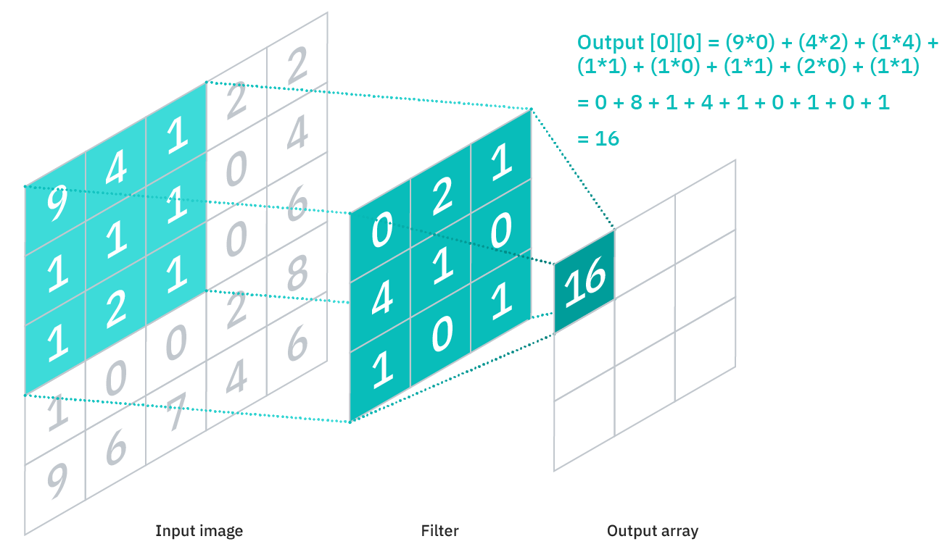
Convolutions
A single kernel is a K × K × C block of learnable weights where K is the length and width of the block and C is the depth of the block, represented as the number of input channels to the kernel, e.g. 3 in the case of an RGB image.
A kernel is slid across an input with some stride length s and at each step, and a 3D dot product is taken between the kernel weights and the K × K × C section of the input that aligns with the kernels current position.
Each dot product computes a scalar value that is aggregated into a 2D output channel

Slide 53
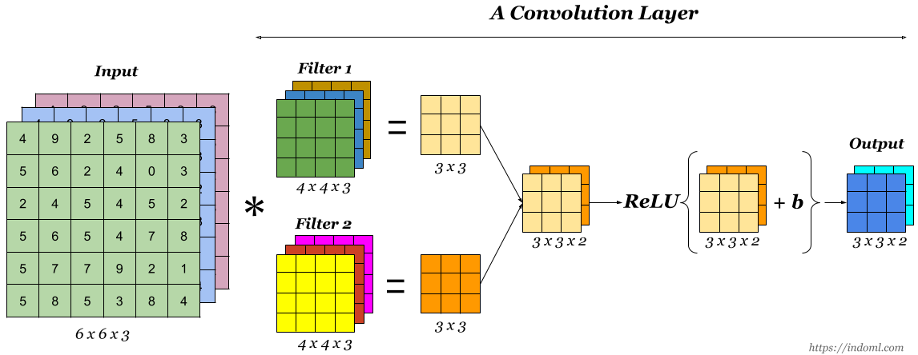
Convolutions
There is an output channel for each kernel, and these outputs are aggregated into one volume along the channel dimension. This output volume is then fed through a non-linear activation function and then into the next layer of the network, such as another convolution layer.

Slide 54
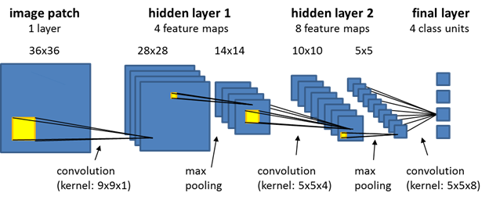
CNNs

Slide 55

Better optimizers
SGD is quite simple, turns out we can do better.
Remember SGD is noisy.
$$W ≔W−α\frac{∂J(W,b)}{∂W}$$
$$b ≔b−α\frac{∂J(W,b)}{∂b}$$

Slide 56
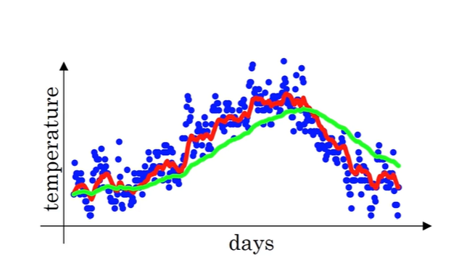
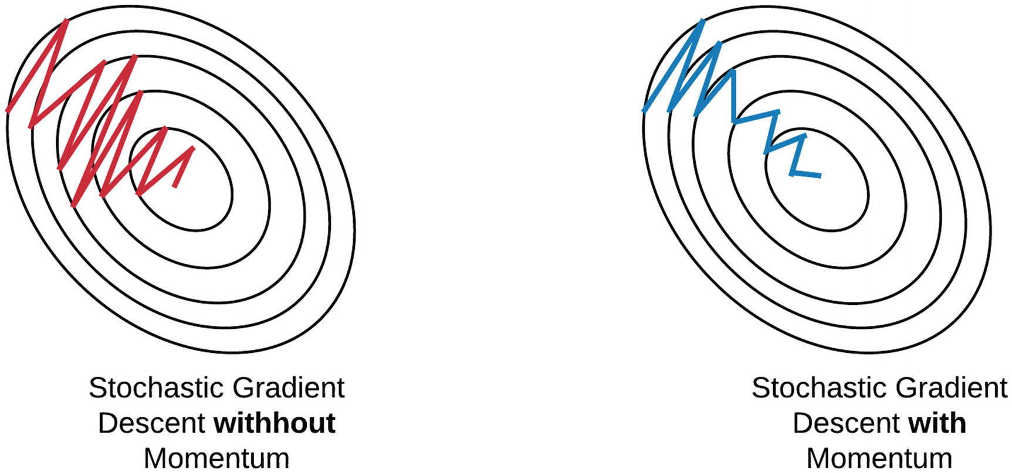



Better optimizers
We can smooth out the oscillation by updating the weights with an exponentially moving average of the gradients over time.
$$v_{t}=βv_{t−1}+\left(1 −β\right)θ_{t}$$
$$β=0.9$$
$$β=0.98$$

Slide 57
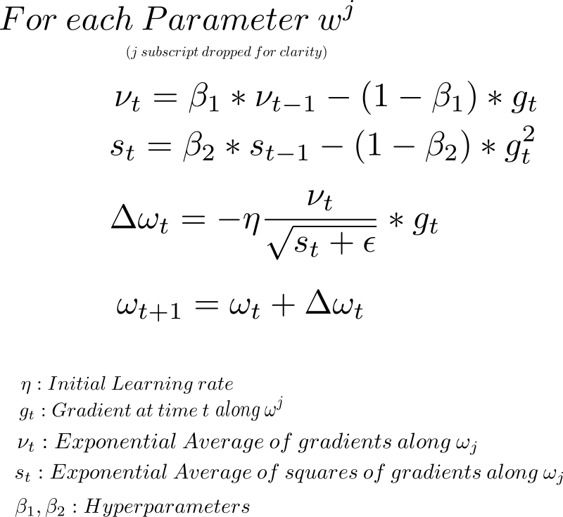
Better optimizers
This is the idea behind optimizers such as Adam, RMSProp, and SGD with Momentum
Equations for the Adam optimizer:

Slide 58
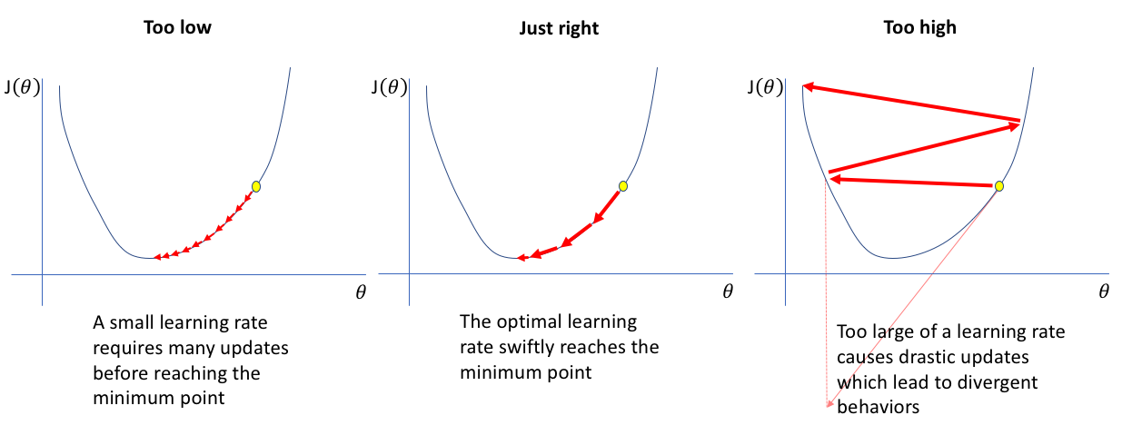
Learning Rate Scheduling
To eek out the best performance, you usually need to change the learning rate throughout training.

Slide 59
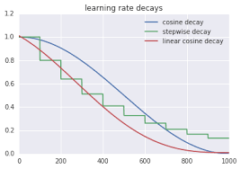
Learning Rate Scheduling
To eek out the best performance, you usually need to change the learning rate throughout training with some learning rate decay schedule.

Slide 60
Batch Normalization
A concept called batch normalization has been critical to high performing deep neural networks in recent years.
Batch normalization makes models more robust to different hyperparameter choices, speeds up training, enables the training of deeper models
Batch norm normalizes the outputs of hidden layers of the network (before the activation function), in addition to the inputs.
There are additional learned weights to scale and shift the normalized hidden features. These are referred to as batch normalization layers.

Slide 61
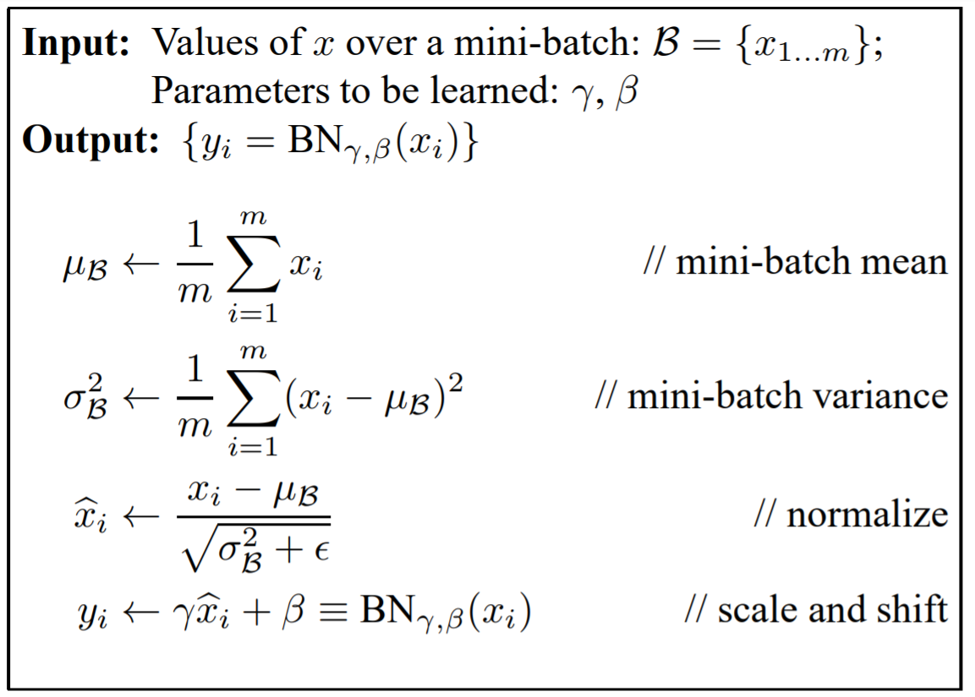
Batch Normalization

Slide 62
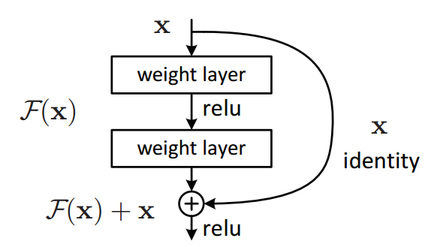
Residual Connections
Residual Connections: add the input to the previous layer to the output of the next layer.
Found in the majority of modern neural nets.
Networks have been shown to perform better as they get deeper, however information gets harder to propagate when the model is forced to learn too many sequential non-linear transformations.
Residual connections help remedy this

Slide 63
Workshop

Slide 64
Download anaconda if you haven’t already: https://www.anaconda.com/
Run Anaconda Prompt. You can search for it in the windows search bar.
Turn off conda ssl
conda config --set ssl_verify false
Create a conda env:
conda create --name a4h-workshop
If you haven’t already, install pytorch and matplotlib for the CPU via pip
pip3 install torch torchvision torchaudio matplotlib --trusted-host download.pytorch.org --trusted-host pypi.org --trusted-host files.pythonhosted.org
Clone the workshop repo: https://github.com/rdmelze/a4h-dl-workshop-2022

